Slide 1

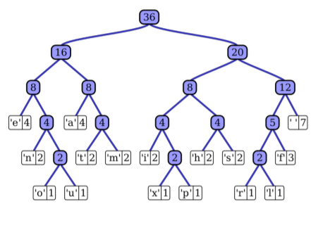
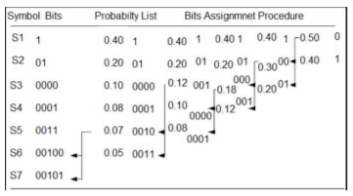
Ishan Khanna
2K19/EE/120

Slide 2

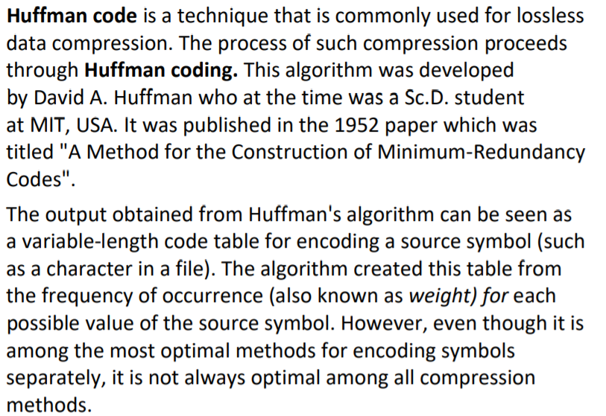
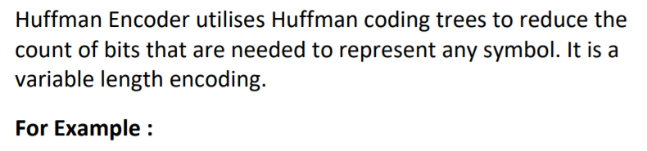
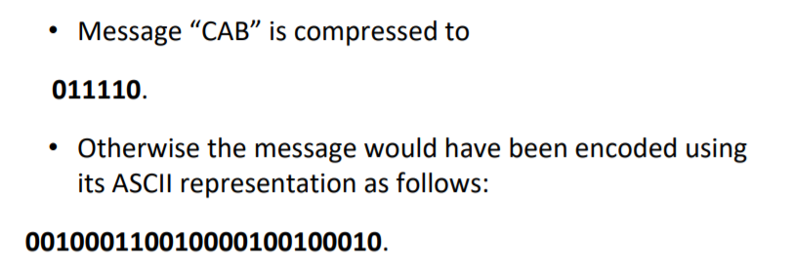
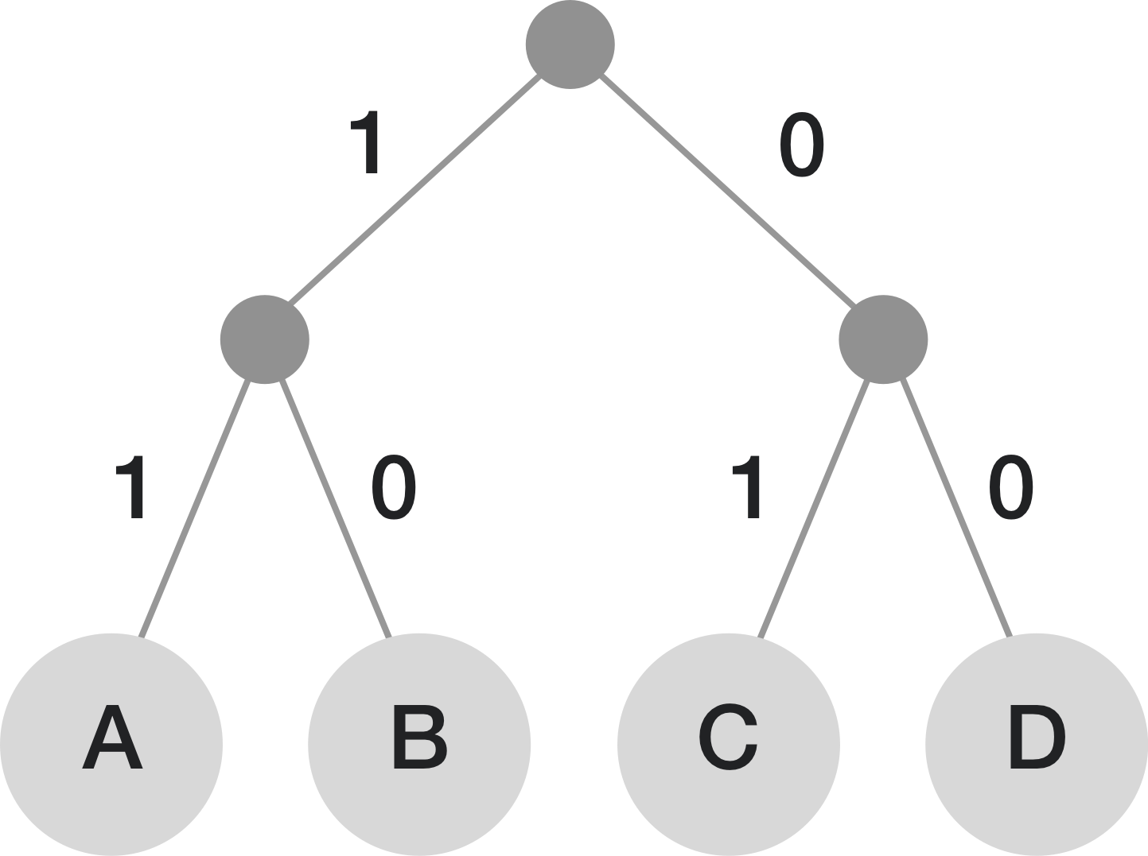

Slide 3

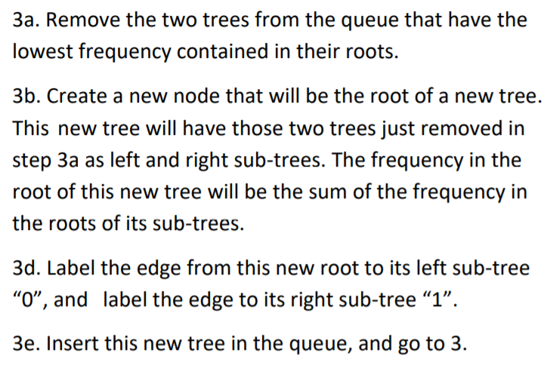
Find the frequency of each distinct symbol in the input.
Make a priority queue of single-node trees. Every node in the initial queue represents a distinct symbol from the set of possible symbols, and contains the frequency of that symbol in the message to be coded. Symbols with a frequency of zero are ignored.
Loop while there is more than 1 tree in the queue:
4) Return the one tree in the queue as the Huffman code tree.

Slide 4

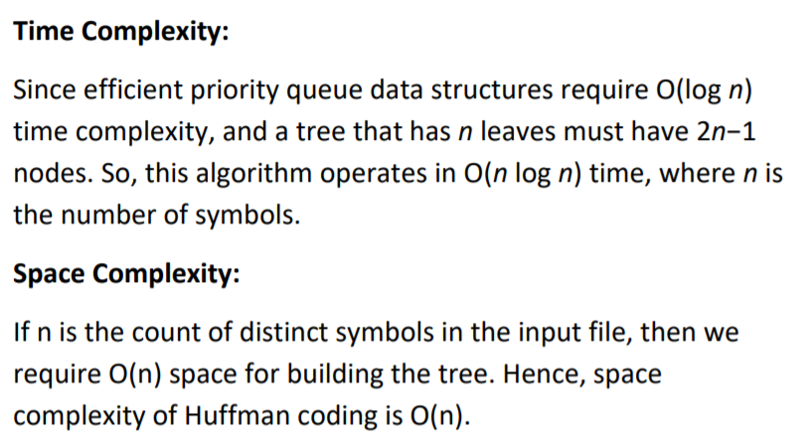

Slide 5

I have built a GUI using Qt5. It includes a text view and an image view.
The text view provides basic text editing features along with the options to compress and decompress the currently opened file.
It also has provisions for sharing by e-mail option printing.
The Image View includes an in-built image-display area and options to compress the file to JPEG.
It also provides an option to print the image and to open an image for viewing.
Features:
Text editor – Cut, Copy, Paste, Undo, Redo
Text Compression
Text Decompression
Image Viewer
Image Compression
Sharing by Mail
Print

Slide 6

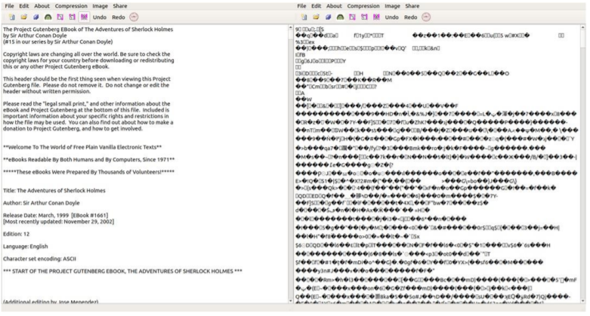
Text Compression

Slide 7

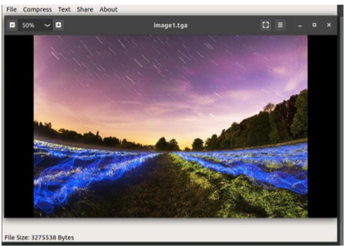
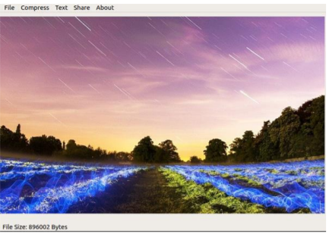
Image Compression

Slide 8
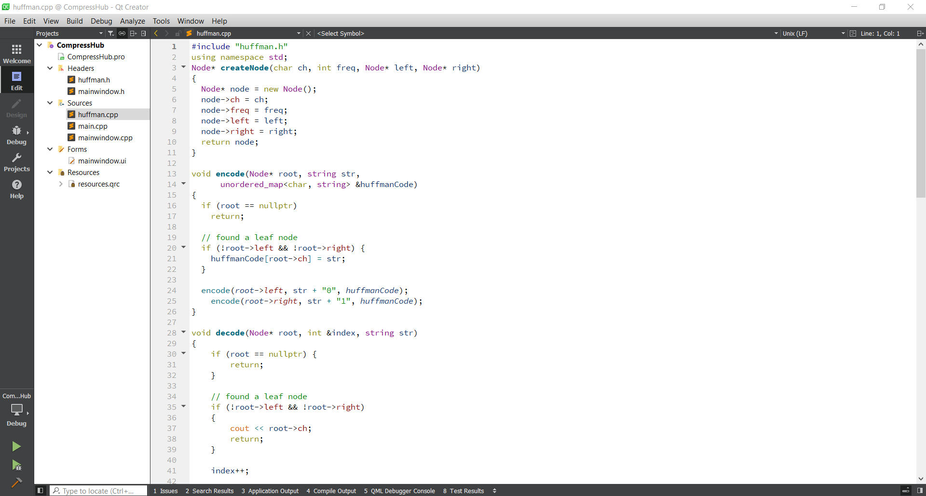

Slide 9
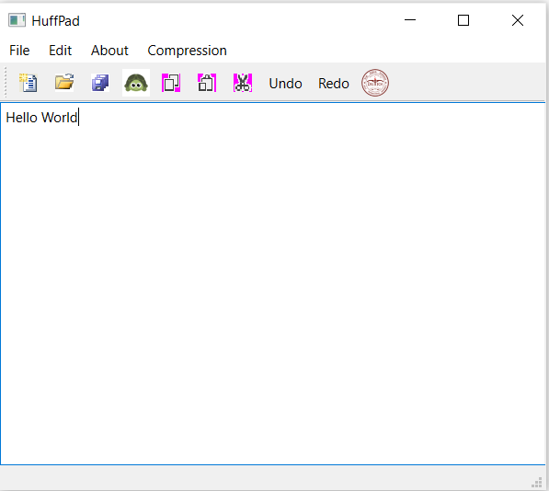
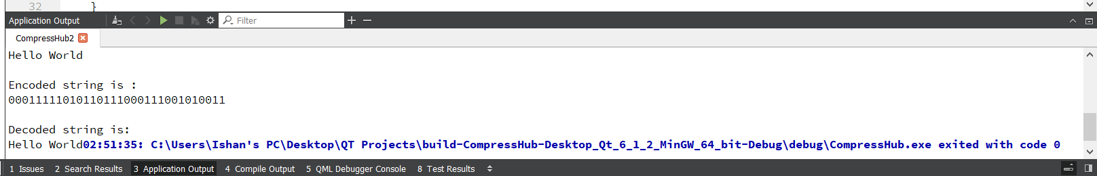

Slide 10
